Slide 1
The maps we take for granted

Slide 2
Maps are important
Who used a map to come to this event?
What map did you use? Why?
How much did you pay to use or have this map?

Slide 3
Maps are expensive
Need for trained cartographers, which venture the land
Need to buy data from third party sellers

Slide 4
Maps are expensive
Google Maps costs around 1 billion dollar/year to maintain
(This number is a rumor, no official sources exist)
  Buying of satellite data
  Buying and making map data
Google Streetview costs between $200 and $1150/km
Google bought Waze for 1.1 billion dollar
Nokia bought Navteq for 8 billion dollar and ‘burns’ 1 billion a year
Apple burns around 1 billion dollar/year as well

Slide 5
Maps are taken for granted
Each map service is free to use for consumers
A platform without maps is considered not attractive
  Microsoft, Apple, Google all have their own map platform

Slide 6

Where does the money come from?

Slide 7


Slide 8
Notes:
Why are these shown? Why not a very recognizable spot? Such as the stations?

Slide 9

Google Maps is advertising
Google makes money by
placing ads on the map
giving some venues more priority in search
Notes:
Who remembers this

Slide 10

Google Maps is tracking
Google tracks your searches and location through maps,
under the guise of features
“Share your location”, “Find my phone”, “Where am I?”
Very valuable information
Better ads
How effective is an ad pin?
...
Notes:
Who remembers this

Slide 11
Google Maps is unfair
There is no advertising money to be made in rural and poor areas…
… thus Africa is mainly unmapped
An adage says that google only maps ‘within 100 miles of a Starbucks-coffeeshop’
Notes:
Who remembers this

Slide 12
Google Maps is a Monopoly
Little incentive for other companies to provide cartography services
Who still buys paper maps?
Only a few other players in the cartography space:
  Bing
  Apple
  Mapquest
  Yandex
  Here WeGo (formerly Here Maps and Nokia Maps)
Notes:
Who remembers this

Slide 13
Google Maps is expensive for devs
Little incentive for other companies to provide cartography services
Over 25K visitors a month?
  Pay big!
Sudden price hike at 1th may 2018
Notes:
Who remembers this

Slide 14
No map source is open*
Having spatial open data available is a huge benefit for research, privacy and freedom
Map licenses can be very costly
*anno 2004

Slide 15
until in 2004...
Steve Coast started OpenStreetMap, out of frustration that no map data is freely and openly available
“I drew a little bit of the world, help me to draw the rest!”
Inspired by the success of Wikipedia
Total joke for the first years...

Slide 16
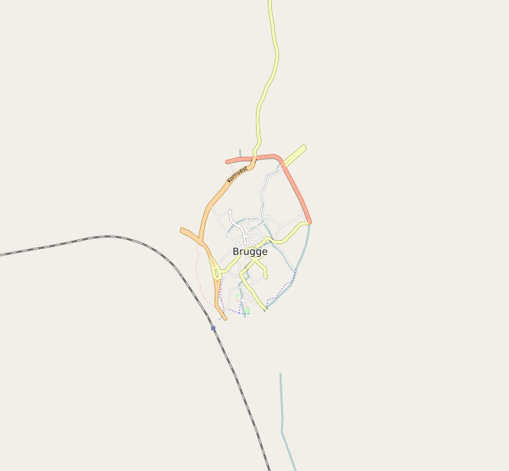
Bruges anno 2007

Slide 17

Bruges anno 2007

Slide 18
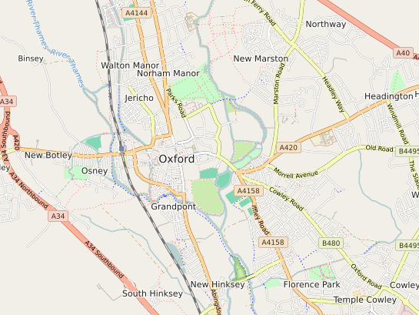
Meanwhile, in Oxford...
University of Oxfords shows an OSM map on their website

Slide 19
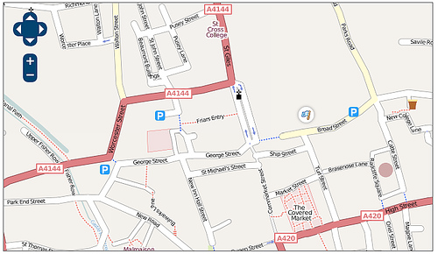
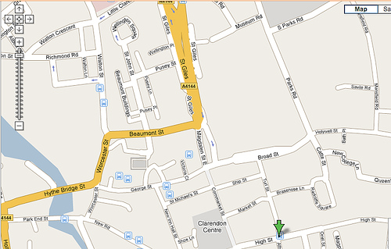
Meanwhile, in Oxford...
Links: OSM; rechts: Google

Slide 20
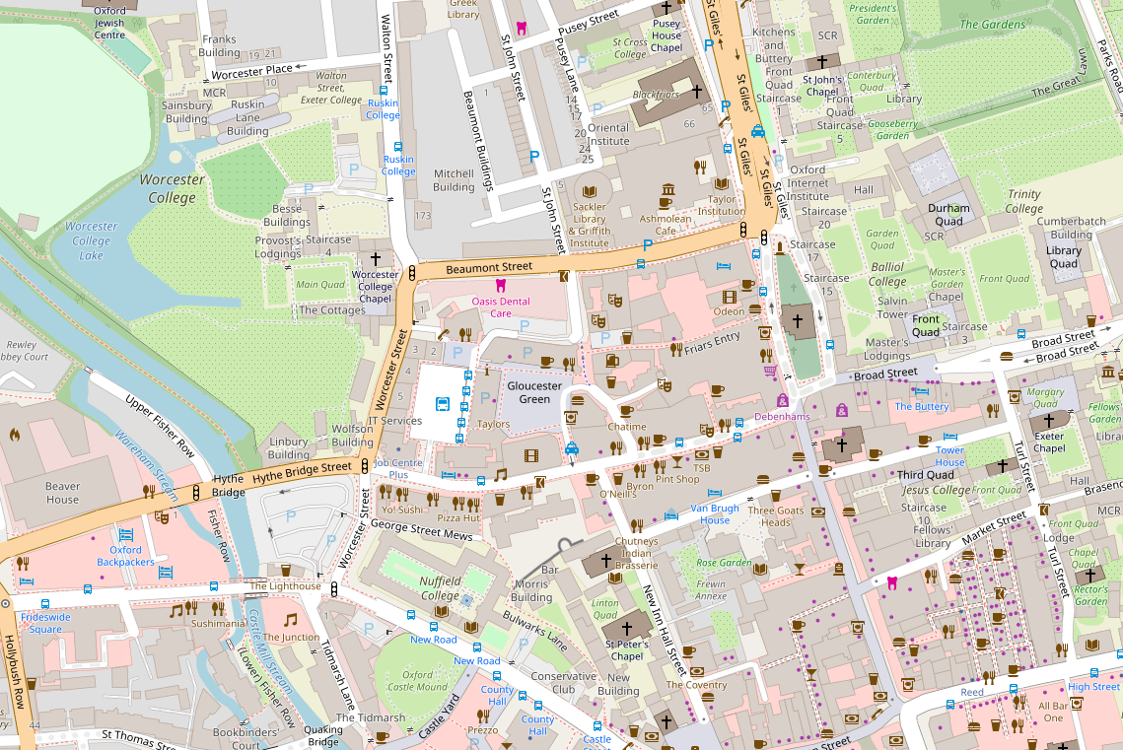
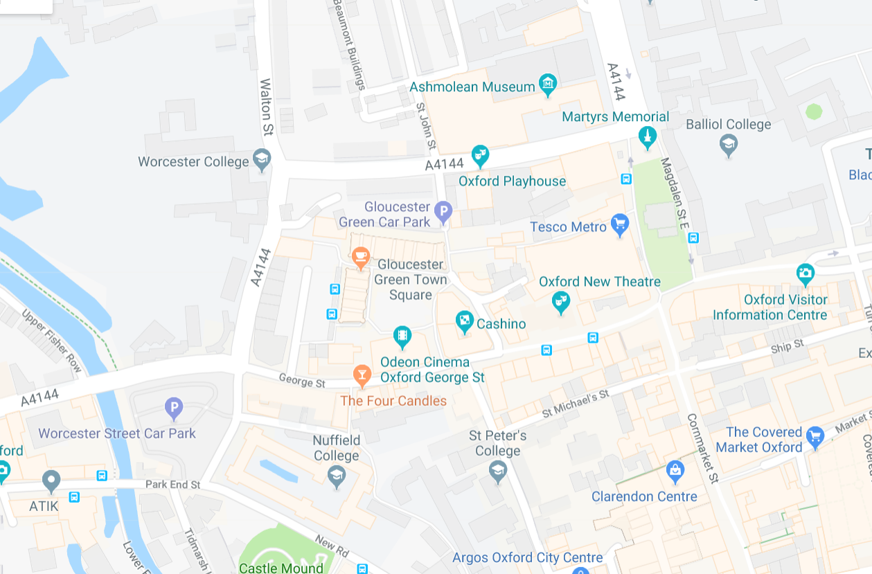
Meanwhile, in Oxford...
Links: OSM; rechts: Google

Slide 21
Growth of OSM...
Gradually, an ecosystem with plenty of tools and actors has grown
OSM seeps into more and more applications
  Humanitarian, commercial, indoor, trains, infrastructure, power lines, …
Today a very mature map, with lots of detail on various topics
Although the tools are not as polished as a 1 billion dollar/yr map…
… tons of use cases and creative applications

Slide 22

Example use cases
Navigation of cars, cyclists, pedestrians, wheelchairs, boats, …

Slide 23
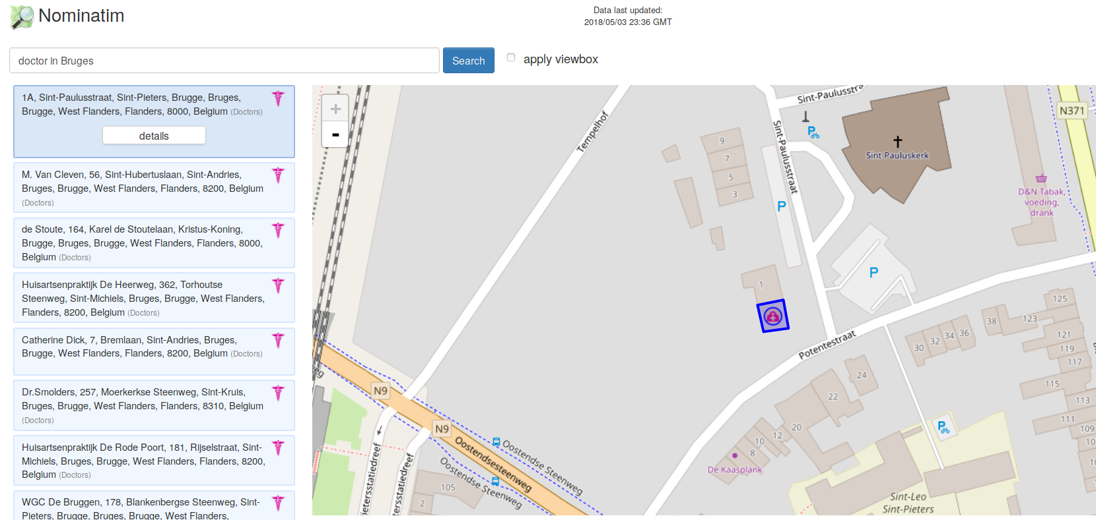
Example use cases
Searching POI’s such as doctors, shops, hotels, ...

Slide 24



Example use cases
Red cross/MSF to have maps in rural Africa
  Base map created at mapathons, finished on the ground

Slide 25
Example use cases
Map of specific stuff, such as
  Heritage
  Parks and ponds (#Pokemon Go)
  Surveillance cameras
  Ski route map
  Cobblestones
  ...

Slide 26
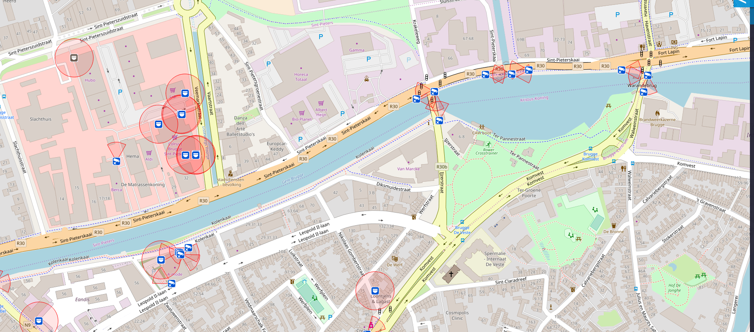

Slide 27


Slide 28

Research
Szell, M. (2018). Crowdsourced Quantification and Visualization of Urban Mobility Space Inequality. Urban Planning, 3(1), 1-20. doi:http://dx.doi.org/10.17645/up.v3i1.1209

Slide 29
What makes OSM great?
ODBL
No goal of profit; thus freedom
Three rules

Slide 30
ODbL
Open Database License
  All data can be used by everyone, for any purpose
  If you add similar data on top of it, this data becomes ODbL too
    (although interpreted quite strictly by OSMF)
  If you redistribute the data, it should be DRM-free
  Mention the source of the data

Slide 31
OSM has no goal of profit
Thus, no need for the ‘Starbucks-test’
Everyone can map what is important for him
  Roads, cycleways, camera’s, statues, heritage, forests, houses, doctors, amusements parks, railways, ...
Of course, a certain rendering of the map gives focus
  E.g. a map with cycle routes, doctors, banks, playgrounds….
  … but everyone is free to make their own rendering!

Slide 32
The Rules of OSM
Only add things that are verifiable ‘on the ground’
and that are permanent
Do not copy data from other sources
unless with permission
If you use the map or data, mention OpenStreetMap
and preferably, give back some data

Slide 33
Everyone helps each other out
Infrastructure to fix your mapping problem...
…and is reused for everyone else

Slide 34
Using OpenStreetMap

Slide 35
Where to start using OSM?
On mobile: navigation apps
  OsmAnd (Android, less features on iOS)
  MAPS.ME
Online
  Openstreetmap.org
  Mapcat.org
  umap.openstreetmap.fr
  overpass-turbo.eu
  …
On your own website
  Leaflet.js

Slide 36
Navigation on your smartphone
I’m a huge fan of OsmAnd
Once the maps are downloaded, works fully offline
Does not track
Lots and lots of features (cycling routes+navigation, spoken instructions, search, …)
Cons:
Limited downloads and only monthly updates for free users (or install via FDroid)
Bit of a learning curve
Eats storage (for maps) and battery (for rendering)

Slide 37




Slide 38
Webmap
Openstreetmap.org has decent search and POI
  duckduckgo users: !osm <some address or name>
Mapcat shows more information on POI
Lots of specific renderings exist
  opencyclemap
  opensnowmap
  openseamap
  openlevelup
  ...

Slide 39



Slide 40


Slide 41


Slide 42
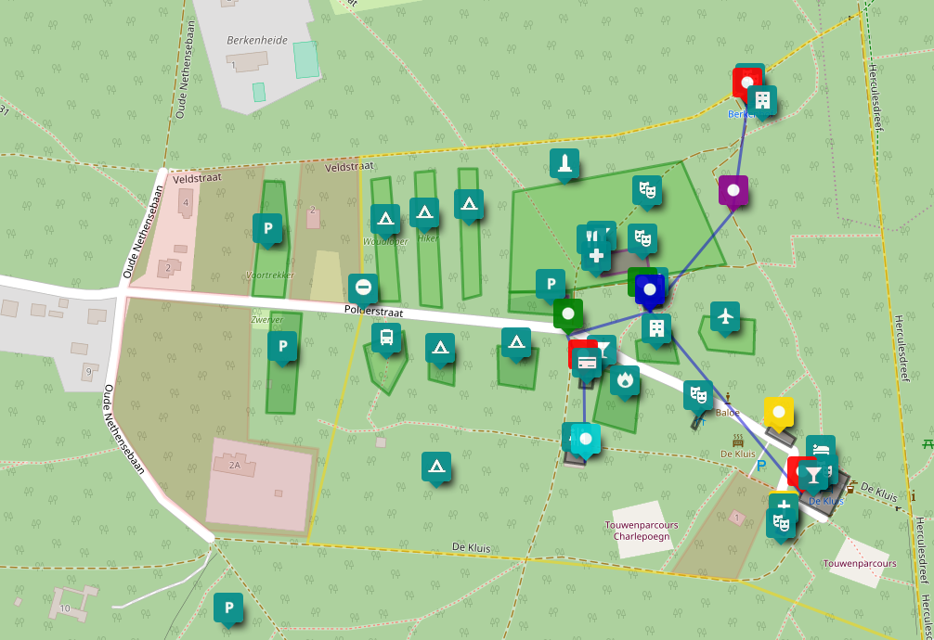
Personal webmap
Want to draw on a map with temporary stuff: umap.openstreetmap.fr
Only use if the data is never relevant for the map:
  Preparation of your trip
  Preparation of an event
  Pins of where you have been
  ...
Voorbereiding Fri3d camp 2018

Slide 43
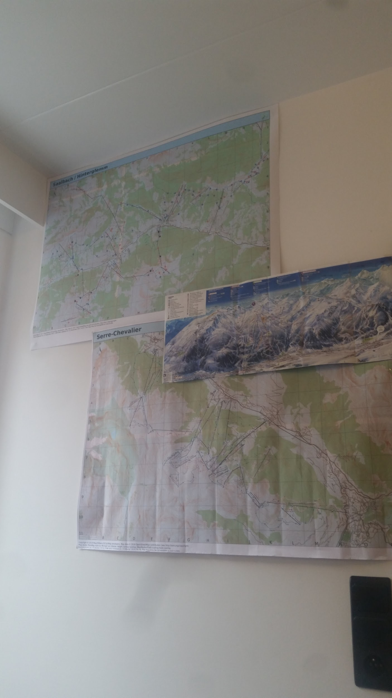
On paper
Get a high resolution map at
https://maposmatic.osm-baustelle.de/
Get it printed in a copy shop nearby

Slide 44
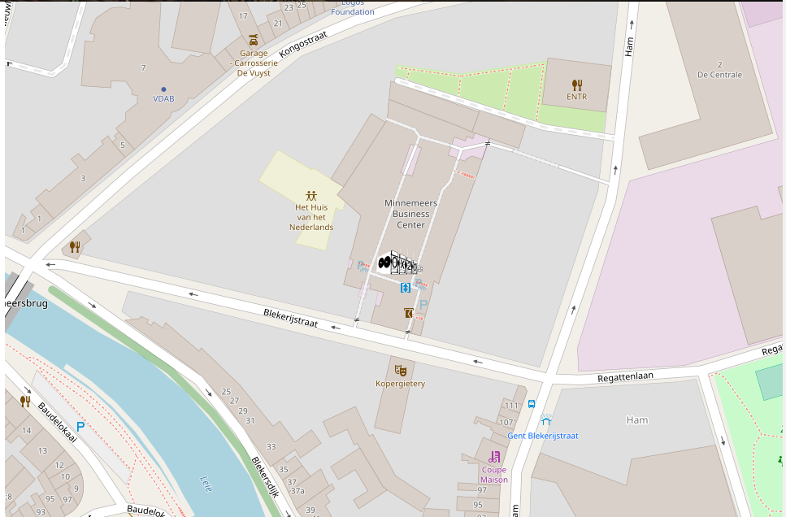
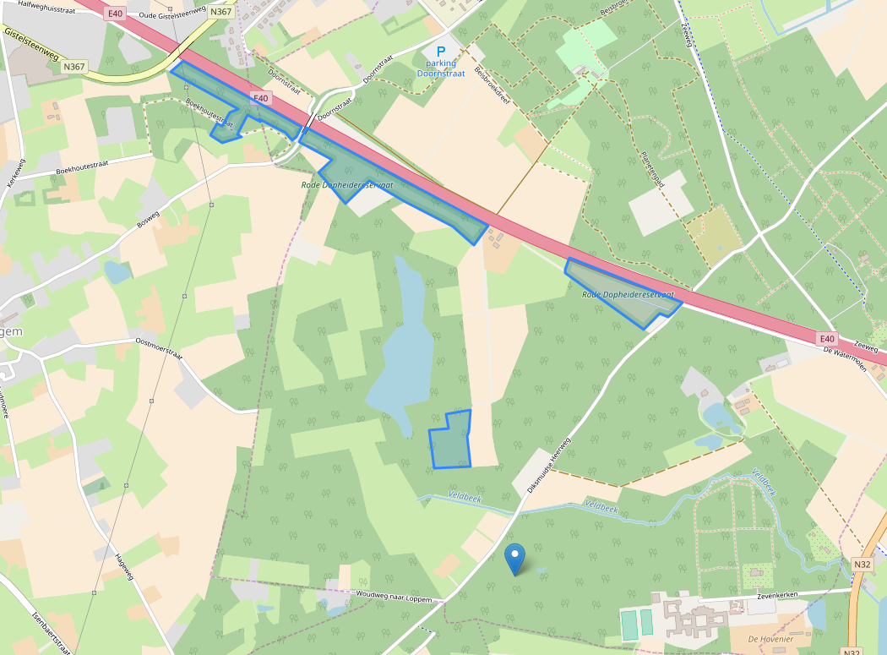
On your own website
Leaflet.js
Shows a slippy map, adds pins, icons, polygons, overlays …
Very friendly and well-documented

Slide 45
For nerds
Overpass-turbo.eu
Query the map data
E.g. get me all trees which are named: natural=tree && name~*
Export the map data as json, gpx, ...
  To import in other tools, such as OsmAnd
  To show on other maps, e.g. in leaflet (camera map, cobblestone map)

Slide 46
Let’s get technical

Slide 47
OSM dataflow
OpenStreetMap.org Map
t
small changes
OSMAND app
OpenStreetMap.org Database
t
t
overpass-turbo.eu
t
t
researchers
t
Contributors
t
Wikipedia
t
Pokemon Go
….....
….

Slide 48
Where does data come from?
Survey! Go out and look for yourself!
  A fun hobby and good excuse to come outside

Slide 49
Where does data come from?
Survey! Go out and look for yourself!
  A fun hobby and good excuse to get outside
Aerial imagery
  Quite a few datasets are available with permission
  Donated by various companies for various reasons

Slide 50
Where does data come from?
Survey! Go out and look for yourself!
  A fun hobby and good excuse to come outside
Aerial imagery
  Quite a few datasets are available with permission
  Donated by various companies for various reasons
Other maps or datasets
  E.g. open data published by governments
  Always be very careful with imports. Consult the community (esp. if >100 items)

Slide 51
Editing OSM

Slide 52
Making our own changes
We always edit the main database
Changes are propagated to others after minutes, hours, days or months
  E.g. overpass updates every minute, OsmAnd every month, …
  The main map can take a few minutes up to a few days as well
Editing is done from an account
  Reading the data is always possible, especially anonymous

Slide 53
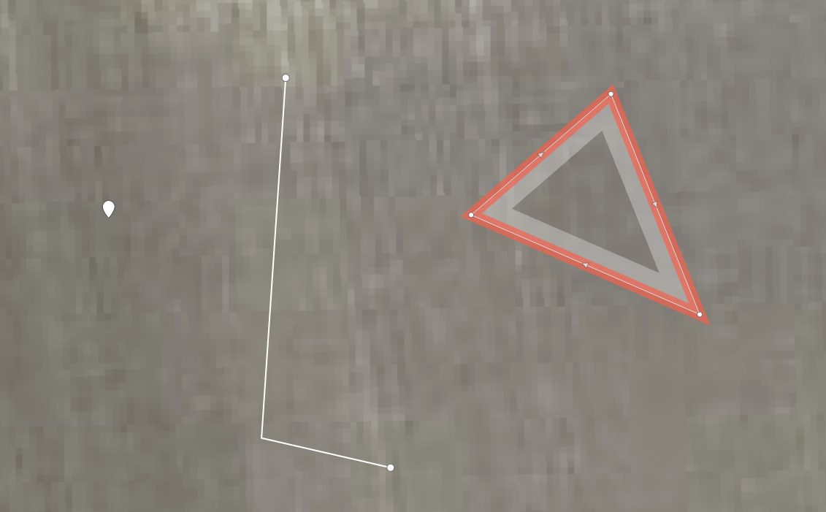
Basic types
Notes:
O

Slide 54
Basic types
Point
(coordinates)
Notes:
O

Slide 55
Basic types
Point
(coordinates)
Line
(multiple points)
Notes:
O

Slide 56
Basic types
Area
(closed way)
Point
(coordinates)
Line
(multiple points)
Notes:
O

Slide 57
Basic types
Area
(closed way)
Point
(coordinates)
Line
(multiple points)
Relation
(collection of other stuff)
Notes:
O

Slide 58

Tags
There is something there… but what?
We tell OSM what something is with Tags

Slide 59

Tags
There is something there… but what?
We tell OSM what something is with Tags
E.g. a tree

Slide 60

Tags
There is something there… but what?
We tell OSM what something is with Tags
E.g. an oak tree

Slide 61

Tags
E.g. an oak tree which is 100m tall, has a diameter of 2m, has been planted in 1812 and is marked as heritage by Erfgoedcel Brugge with reference number 681

Slide 62
Tags: how to use them
The property that is defined
The value

Slide 63
What tag should I use? Some pointers
A facility? amenity=* (school, doctor, hospital, drinking_water, bench, …)
A shop? shop=* (chocolate, clothes, second_hand, electronics, …)
Another building? building=* (yes, house, apartment, office, …)
Something to go to in your free time? leisure=* (park, nature_reserve, picnic_site, ...)
A road or path? highway=* (residential, primary, cycleway, footway, path, …)
  Mainly on ways
Notes:
Tagging has grown over the years, and is sometimes a bit clunky due to historical reasons

Slide 64
What tag should I use? Some pointers
Extra tags which are often used
Does it have a name? Add name=*
Does it need an extra description? Add description=*
Does it have a reference number? Add ref=*
Does it have an address? Use addr:street=*, addr:number=*, addr:unit=*
The presets often help a great deal by offering default tags

Slide 65
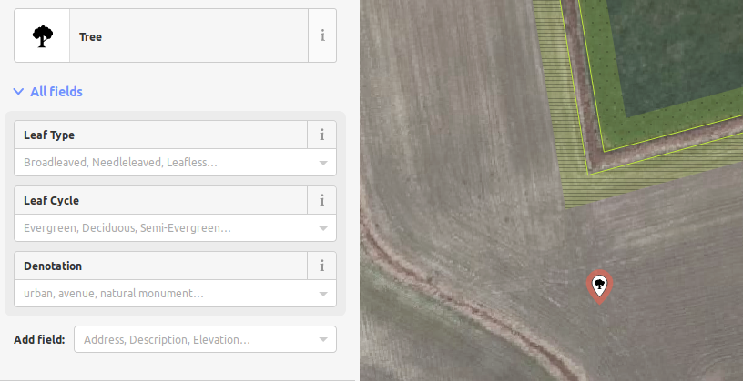
What tag should I use? Some pointers

Slide 66
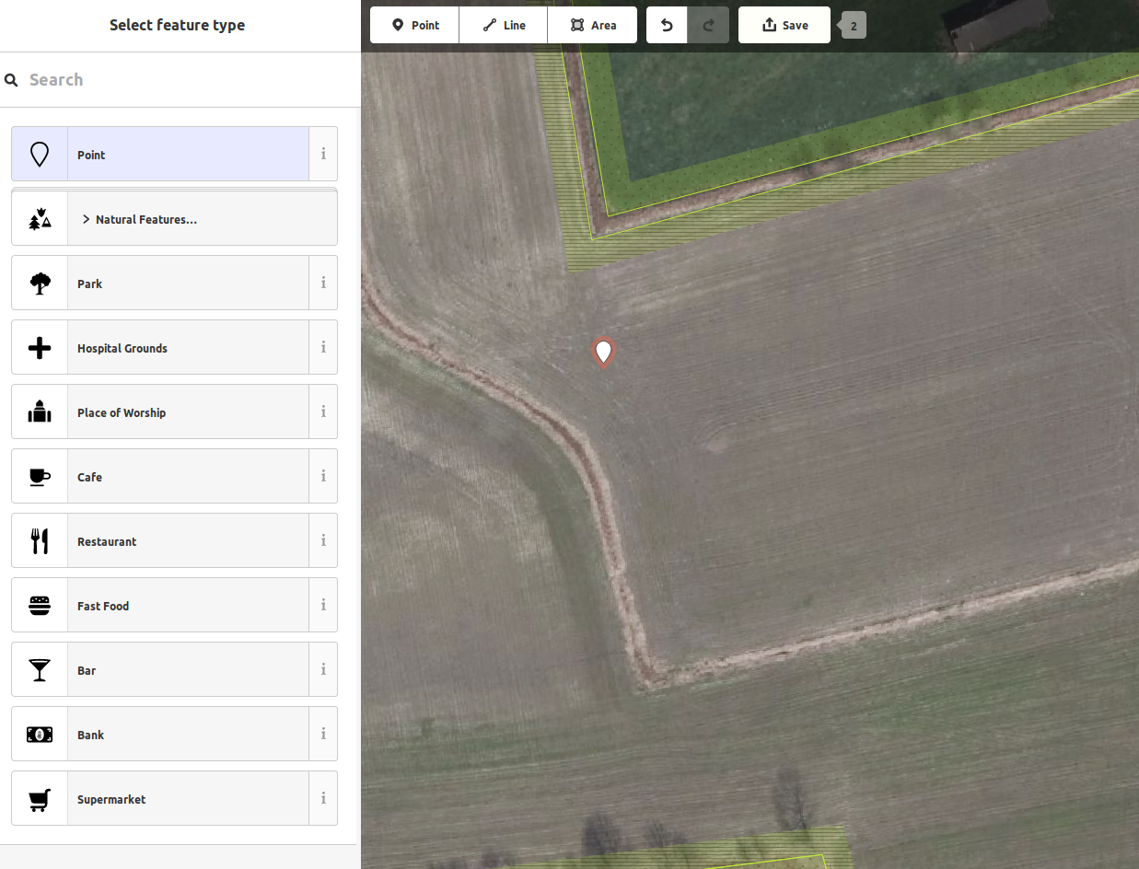
What tag should I use?
If you don’t know how to tag something:
Use the presets of the website

Slide 67
What tag should I use?
If you don’t know how to tag something:
Use the presets of the website
Search wiki.openstreetmap.org
  Users of duckduckgo: type !wosm

Slide 68
What tag should I use?
If you don’t know how to tag something:
Use the presets of the website
Search wiki.openstreetmap.org
  Users of duckduckgo: type !wosm
Ask someone experienced
  A friend
  The local chat channels or mailing list
  Mailinglist tagging@openstreetmap.org

Slide 69
What tag should I use?
If you don’t know how to tag something:
Use the presets of the website
Search wiki.openstreetmap.org
  Users of duckduckgo: type !wosm
Ask someone experienced
  A friend
  The local chat channels or mailing list
  Mailinglist tagging@openstreetmap.org
Still no suitable tag found? Invent one!

Slide 70
Done drawing?
Press ‘Upload changes’ and give a short, meaningful explanation of what you did (a commit message).
Your contribution is now live!
The actual map will update after a few minutes (up to a several hours)
Other apps/websites will update later, depending on the app
  OsmAnd updates once a month
  Maps.Me with every new release
  PoGo when they feel like it

Slide 71
Community

Slide 72
More than ‘just the map’
People are enthusiastic about it across the globe
Connect with your local community. In Belgium:
We hang out digitally on riot: https://riot.im/app/#/room/#osmbe:matrix.org
We meet every now and then: https://www.meetup.com/OpenStreetMap-Belgium/
But also internationally
State of the map
WeeklyOSM newletter
Reddit

Slide 73
Recap

Slide 74
Recap
A global map should be a public resource
Keeping it up to date is our shared responsibility
Propertierty maps are manipulative

Slide 75
Recap
Openstreetmap is cool!
OSM has three rules
  Map only facts on the ground
  Make no copyright infringements
  Give credit to OSM where credit is due
OSM uses tags to describe features
  There are a lot of them
  The wiki describes them, or ask the community

Slide 76
Recap
Use overpass-turbo.eu to query the map
Leaflet.js if you need a map on your website
umap.openstreetmap.fr to draw a personal map
OsmAnd for Android (or maps.me)
Lots of other tools exist! Do some research

Slide 77
Recap
Get in touch with the local guys
  for questions
  for fun
  for inspiration
  for hints and cool projects

Slide 78
Recap
Go outside, map stuff and have fun

Slide 79
Sources
http://www.asymco.com/2012/12/18/how-much-to-maps-cost-and-what-are-they-worth/

